Slide 1
Scrum Team 2
Sprint 3

Slide 2
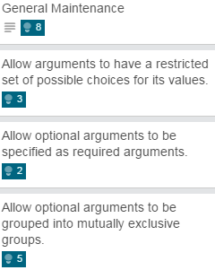
What was pulled?
Total Units Pulled: 18
Total Units Completed: 18

Slide 3
Testing & Code Coverage
100% Pass rate on unit testing
100% Pass rate on acceptance testing
99% Code coverage

Slide 4
Program Demos
All argument types covered
Writes to XML files
Reads from XML files

Slide 5
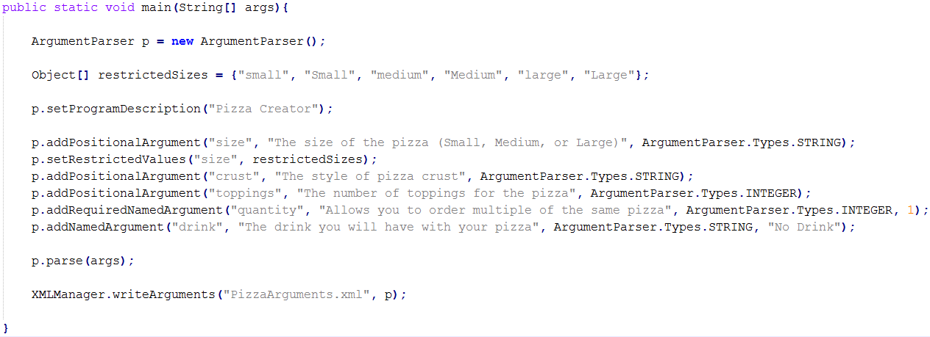
Writing Arguments

Slide 6
Running XML Write Demo
Ran with parameters:
Result: XML File

Slide 7
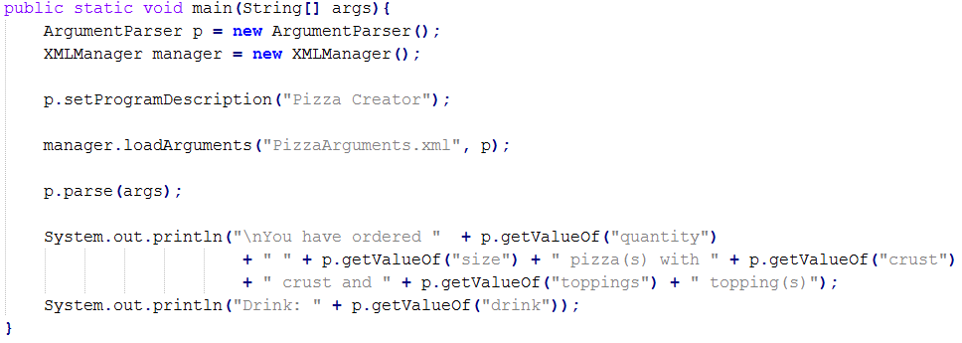
Loading Arguments

Slide 8
Running XML Load Demo
Ran with parameters:
Result:

Slide 9
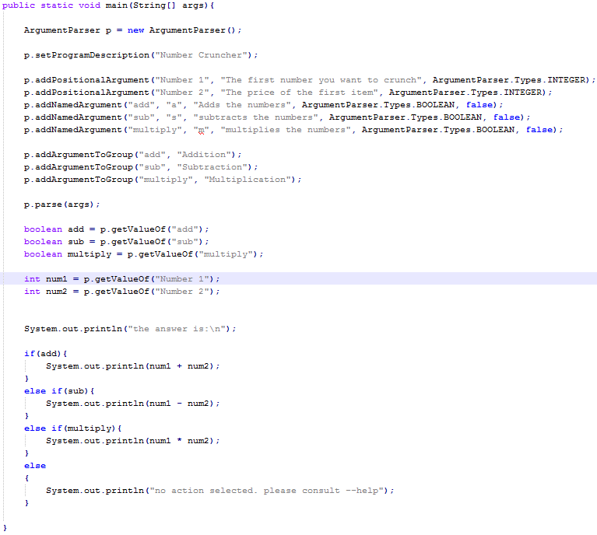
Mutually Exclusive Demo

Slide 10


Running the Addition Demo
Ran with parameters:
Result:

Slide 11


Running the Subtraction Demo
Ran with parameters:
Result:

Slide 12


Running the Multiplication Demo
Ran with parameters:
Result:

Slide 13

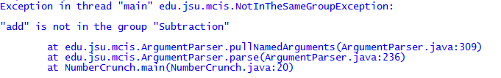
Failing Mutual Exclusion
Trying to run previous demo with parameters:
Result

Slide 14
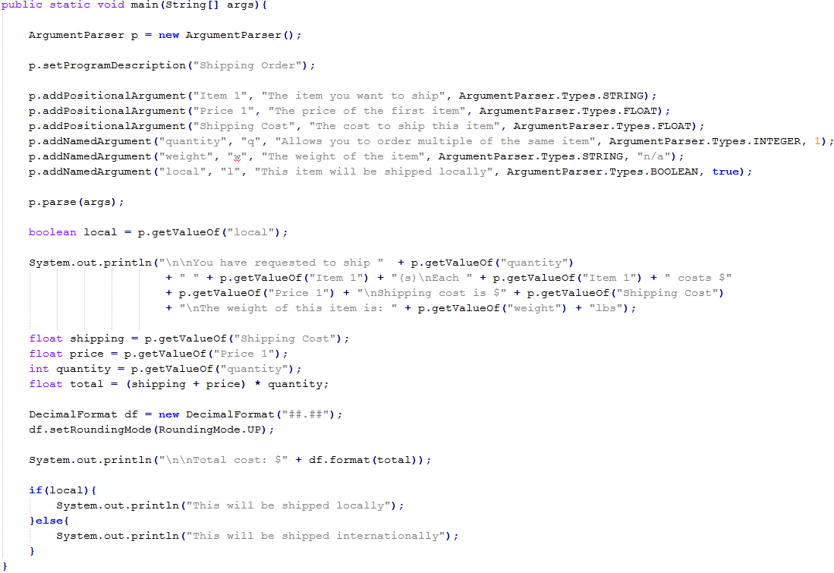
Shorthand Use Demo

Slide 15
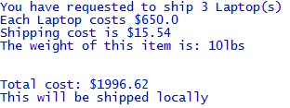
Running Shorthand Demo
Ran with parameters:
Result:

Slide 16
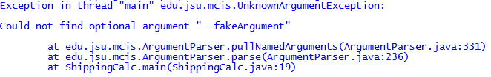
Failing Shorthand Demo
Ran with parameters:
Result:

Slide 17

Thank You For Your Time

